Slide 1
ISO27001:2013 Controls Appendix; Part 10
In this module lets look at ISO27001:2013 (ISMS) related to supplier relationships…

Slide 2
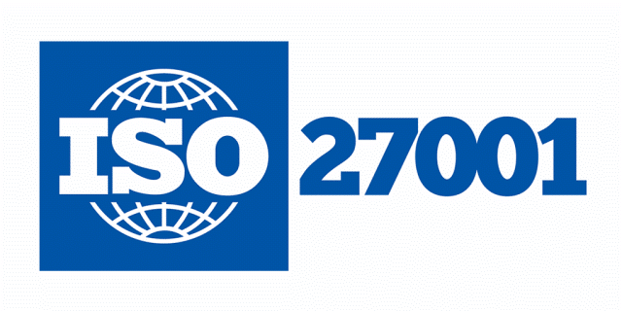
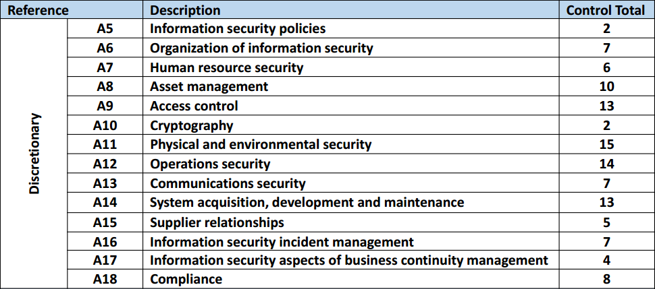
ISO27001:2013 Controls Appendix; Part 10
ISO27001:2013 DISCRETIONARY CONTROLS
TOTAL: 114
https://chapters.theiia.org/bermuda/Events/ChapterDocuments/Information%20Security%20Management%20System%20%28ISMS%29%20Overview.pdf

Slide 3
ISO27001:2013 Controls Appendix; Part 10
A.15 SUPPLIER RELATIONSHIPS
A.15.1 INFORMATION SECURITY IN SUPPLIER RELATIONSHIPS
A.15.1.1 | INFORMATION SECURITY POLICY FOR SUPPLIER RELATIONSHIPS
A.15.1.2 | ADDRESSING SECURITY WITHIN SUPPLIER AGREEMENTS
A.15.1.3 | INFORMATION & COMMUNICATION TECHNOLOGY SUPPLY CHAIN

Slide 4
ISO27001:2013 Controls Appendix; Part 10
A.15 SUPPLIER RELATIONSHIPS
A.15.1.1 | INFORMATION SECURITY POLICY FOR SUPPLIER RELATIONSHIPS | Control: Information security requirements for mitigating the risks associated with supplier’s access to the organization’s assets shall be agreed with the supplier and documented.

Slide 5
ISO27001:2013 Controls Appendix; Part 10
A.15 SUPPLIER RELATIONSHIPS
A.15.1.2 | ADDRESSING SECURITY WITHIN SUPPLIER AGREEMENTS | Control: All relevant information security requirements shall be established and agreed with each supplier that may access, process, store, communicate, or provide IT infrastructure components for, the organization’s information.

Slide 6
ISO27001:2013 Controls Appendix; Part 10
A.15 SUPPLIER RELATIONSHIPS
A.15.2 SUPPLIER SERVICE DELIVERY MANAGEMENT
A.15.2.1 | MONITORING & REVIEW OF SUPPLIER SERVICES
A.15.2.2 | MANAGING CHANGES TO SUPPLIER SERVICES

Slide 7
ISO27001:2013 Controls Appendix; Part 10
A.15 SUPPLIER RELATIONSHIPS
A.15.2.1 | MONITORING & REVIEW OF SUPPLIER SERVICES | Control: Organizations shall regularly monitor, review and audit supplier service delivery.

Slide 8
ISO27001:2013 Controls Appendix; Part 10
A.15 SUPPLIER RELATIONSHIPS
A.15.2.2 | MANAGING CHANGES TO SUPPLIER SERVICES | Control: Changes to the provision of services by suppliers, including maintaining & improving existing information security policies, procedures & controls, shall be managed, taking account of the criticality of business information, systems and processes involved and re-assessment of risks.

Slide 9
ISO27001:2013 Controls Appendix; Part 10
Lets look at incident management in the next module…
END

